Slide 1

Art of Demotivation:
I want to work but Meetings are killing me
By Anthony McKale Associate Director of DevOps and Cloud
Date 12-2023

Slide 2

The 3 basic needs of happy workers
I need to be able to work well
I need to value my work
I need to be valued for my work

Slide 3
The 3 basic needs of happy workers
I need to be able to work well
I need to value my work
I need to be valued for my work

Slide 4
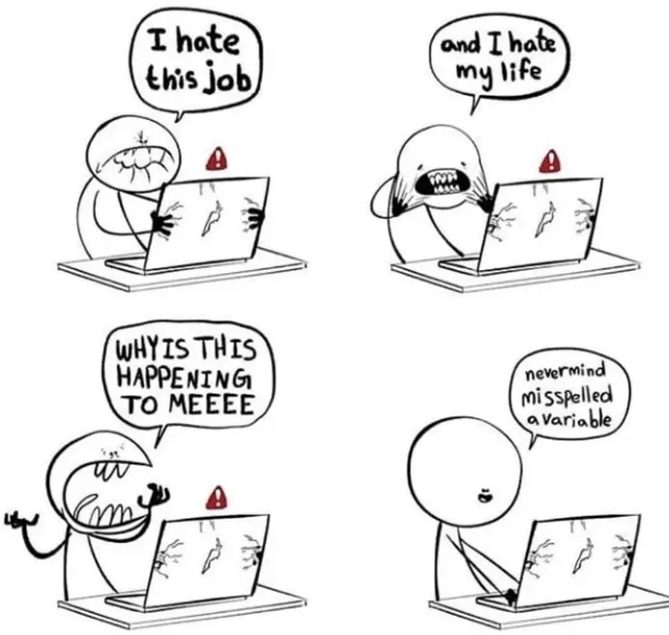
Contents: Make DevOps great again

Slide 5
Contents
I need to be able to work well but…. I have no time
Meetings are a time sink
Email is a time sink
Slack is a time sink
Multiple laptops locking is a time sink

Slide 6
Meetings are a time sink
1) Prioritise your meetings devops team meeting, standups, retros, workshops
2) Book “focus time” as a meeting, aim for 3-4 hours per day as a single block
3) Dual Laptop: Invite client and 6p6 email to meetings to prevent stressful double booking 4) It’s ok to say no to pointless meetings

Slide 7
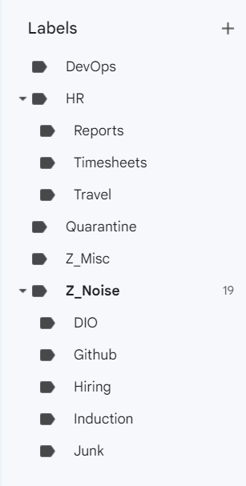
Email is a noisy time sink
Use Rules to filter inbox into buckets
* Rules guide for outlook
https://support.microsoft.com/en-us/office/manage-email-messages-by-using-rules-c24f5dea-9465-4df4-ad17-a50704d66c59 * Rules are called Labels in gmail see step 8 of https://www.loginradius.com/blog/growth/gmail-productivity-tips-to-try-right-now/

Slide 8
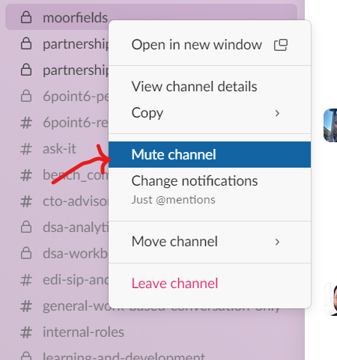
Slack is a interrupting time sink
“Alarm bell in a room of Alarms” Brains like prioritisation not interrupting noise
“Mute” status update or conversation channels, and review then manually on your terms Or “Change Notifications”

Slide 9
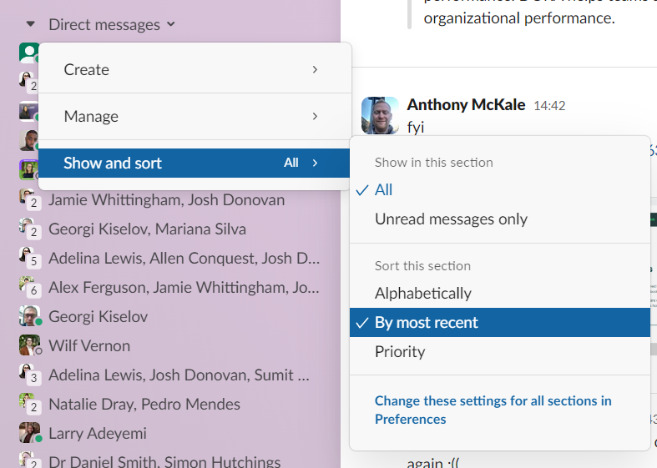
Slack is a confusing time sink
“Cognitive dissonance” Brains like consistency Dancing moving conversations break that Use “Show and sort” to make deterministic

Slide 10
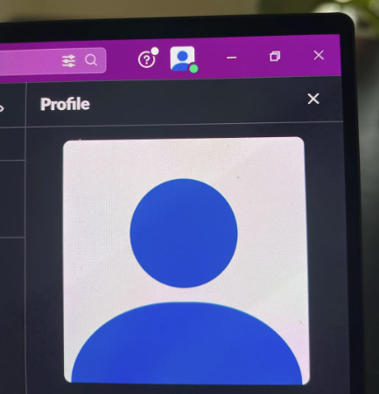
Slack is a confusing time sink
“Cognitive dissonance” Images are simpler than Words Avatars over Names Set Avatars for everything Slack, Teams, Git, Google…
Ask Colleagues to do the same

Slide 11
Team Calls in the office are a noisy business
Help Self: Pods / book a room are good but too few
Book a regular desk far in advance, in quieter bit of the office
If people are just chatting loudy, politely point to your headset to remind them to be more considerate

Slide 12
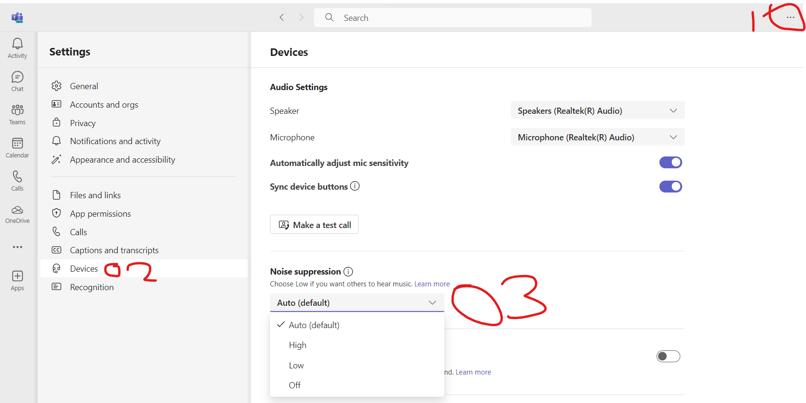
Team Calls in the office are a noisy business
If you can’t help yourself… Help others: Set sound cancelling in teams to “high”

Slide 13
Unlocking laptops is a time sink
Not recommended for just one laptop but… Caffeine if you are working two or three laptops, maybe a good idea But… if used, you MUST manually lock your laptop when it’s unattended (or your liable!) https://www.majorgeeks.com/files/details/caffeine.html https://intelliscapesolutions.com/apps/caffeine

Slide 14

Questions ?
Notes:
Vision film
This is about ambition.
An ambition to improve.
This is about change.
A change to the way things are done.
This is about technology.
Technology that makes brilliant ideas happen.
This is about desire
A desire to stay ahead and succeed.
We know every client is different.
That every challenge is different.
We’re here to harness technology.
To extract maximum value from data.
To navigate complexity.
To secure the right outcome.
Across sectors.
Across the world.
Across every project.
Again and again and again.
Whether building a single click.
To search a million documents.
Or connecting hundreds of data points.
To accelerate decision making.
This is transformation.
Planned right.
Designed right.
Built right.
And delivered right.
This is transformation secured.
That makes brilliant ideas happen.
In the right way.
Welcome to 6point6.
Transformation secured.
Architecture | Cloud | Data | Engineering | Cyber security.

Slide 15
Thank you for your Awesomeness
If you have any questions anthony.mckale@6point6.co.uk #dep-eng-devops (slack)

